Slide 1
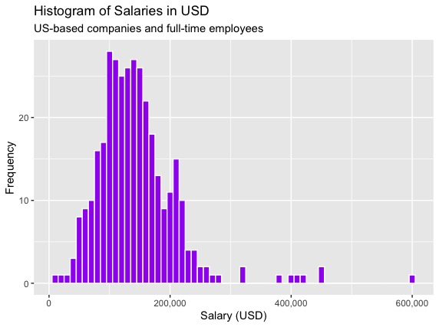
Data Science Salary Analysis: Attracting Top Talent
Adeline Casali, DSE5002
Minimum: $5,679
Median: $136,300
Mean: $144,638
Maximum: $600,000
Notes:
This analysis looked at salaries of full-time employees at US-based companies. These salaries ranged from $5,679 USD all the way to $600,000 USD depending on experience level, job title, and employee residence, with a mean of $144,638 USD.

Slide 2
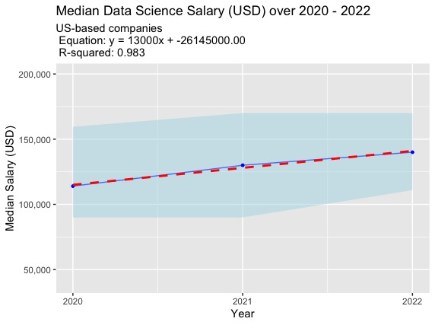
Data Science Salary Trends Over Time
Data science salaries have been growing:
Based on extrapolation from the linear model, the median salary for a data scientist in 2023 will be roughly $156,000 USD.
Year | Median
2020 | $114,000
2021 | $130,000
2022 | $140,000
Notes:
Data science salaries have been growing since 2020. Based on extrapolation from the linear model, the median salary for a data scientist in 2023 will be roughly $156,000 USD. This trend is increasing over time, and may continue to grow in the future as inflation rises.

Slide 3
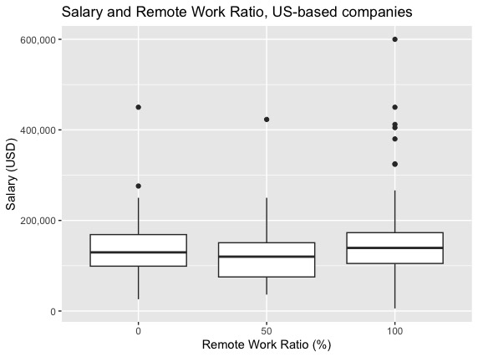
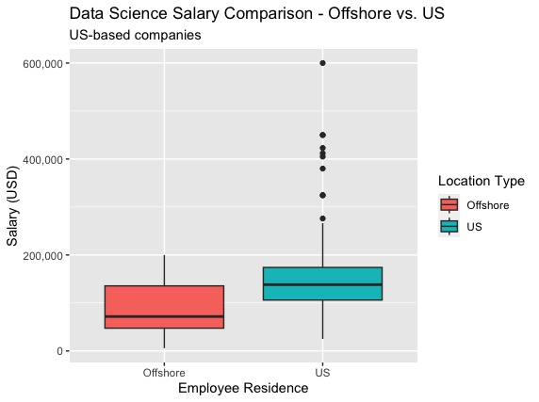
Factors Influencing Salaries
P-value of 0.481 is greater than the significance level of 0.05, so remote work ratio is not going to be deciding factor for hiring and salary recommendations.
P-value is less than significance level of 0.05, so there is a significant difference, and it is less expensive to hire offshore.
Notes:
Based on my findings, remote work ratio does not impact salary. However, offshore hiring does, and is significantly less expensive. However, there may be a language barrier and the employee would have to work remotely and/or be flown onsite.

Slide 4
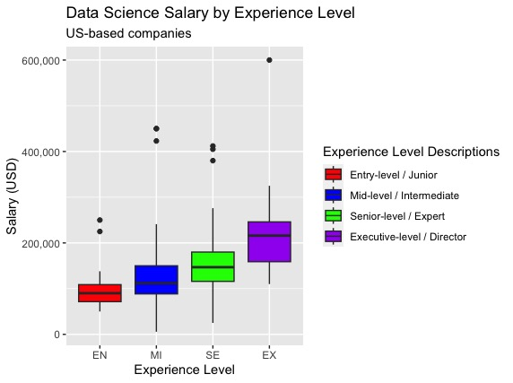
Salary Differences by Experience Level
Median Salaries
Entry-level / Junior: $90,000
Mid-level / Intermediate: $112,000
Senior-level / Expert: $146,900
Executive-level / Director: $216,000
Notes:
Salaries increase linearly as you move up in experience level. Based on the job description and the need to hire someone who can lead a team in the future, I would recommend hiring at the Senior-level / Expert experience level, which has a median salary of $146,900 USD.

Slide 5
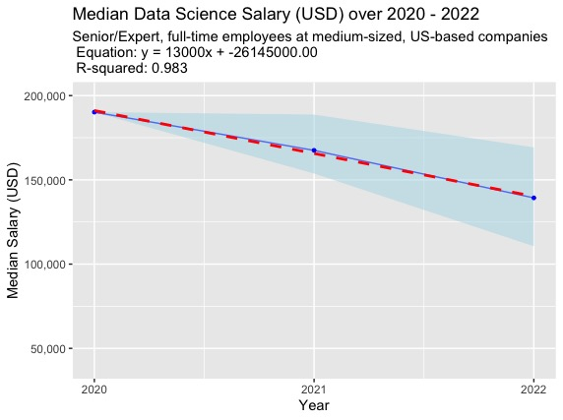
Salary Recommendation: $140,000 - $169,000
Notes:
Based on extrapolation from the filtered linear model, the median salary for a senior/expert level data scientist from a medium sized US based company in 2023 will be roughly $115,000 USD. This trend is decreasing, potentially due to market rebounding after COVID.
Overall, based on all of the above data, I would recommend a minimum salary of $140,000 (USD) up to a maximum of the 3rd quantile salary from 2022 of $169,000 (USD) in order to obtain the most competitive talent, capable of spearheading data science in the company and leading a team in the future. This number could be reduced by roughly $20,000 or more, depending on where in the world the candidate is located, if hiring offshore talent.

